Slide 1

Model View Intent
Architecture
The basics
Notes:
To use this title animation slide with a new image simply 1) move the top semi-transparent shape to the side, 2) delete placeholder image, 3) click on the picture icon to add a new picture, 4) Move semi-transparent shape back to original position, 5) Update text on slide.

Slide 2
What is MVI
Model:
Represents state
Immutable
View:
Activities or Fragments
Where user interacts
Model-View-Intent is one of the newest architecture patterns for Android…
Intent
Not same as Android Intent object
Represents intention or desire to perform an action

Slide 3
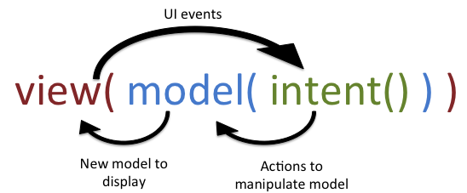
MVI’s superpowers
Unidirectional and cyclical data flow
Think in terms of functional programming
What do we get from this pattern?
A consistent state during the lifecycle of Views
Immutable Models that provide reliable behavior and thread safety on big apps

Slide 4
The Model
This is the most important component in the MVI pattern
Manager of the state
Interfaces with sub-systems
Propagates state to the view
Reduces state from incoming intents
Home of all business logic

Slide 5

A few tips for MVI models
State engine for managing and communicating state
Also helps for which intents can be actioned
Only mutate the state inside of the main thread
For thread safety. We only want to change state in one place
Use RxJava subjects to “cache” state
This way you can resume an activity after a screen rotate
Kotlin is a good language to use here
True immutability and other useful tools

Slide 6
Time for some code

Slide 7
The View
Composite disposable to deal with all of the observables
A single render function to render state
Link UI events to the propagation of intents

Slide 8
Time for some code

Slide 9
Intents
Don’t need their own class, but might need to be separated from the view.
Can cause a transition in state
Feeds into a state reducer on the Model side

Slide 10
Time for some code and a Demo

Slide 11

Why is Ruan’s PR more complicated than this example?
Infrastructure and bindings between the Model and view
Generalization of code for reuse
Recreating complicated features and possibly no state engine to aid with that

Slide 12
Summary
“MVI is all about unidirectional data flow paired with functional and reactive programming. The model represents the state and a view binds itself to this model.”

